Slide 1

INTRODUCTION TO SPRING

Slide 2
Introduction
Spring
  An application development framework and inversion of control container for Java
Spring Boot
  Makes it easy to create stand-alone, production-grade Spring Applications and expose them as services

Slide 3
Spring Framework
Light-weight comprehensive framework for building Java SE and Java EE applications
Java Bean-based configuration management,
Integration with persistence frameworks.
MVC web application framework
Aspect-oriented programming (AOP) framework
Publishing REST API’s

Slide 4
Dependency Injection
A pattern of injecting a class’s dependencies at runtime.
  Achieved by defining the dependencies and then injecting in a concrete class
Can swap in different implementations without having to modify the main class.
Promotes high cohesion by promoting the Single Responsibility Principle (SRP) and low coupling.

Slide 5
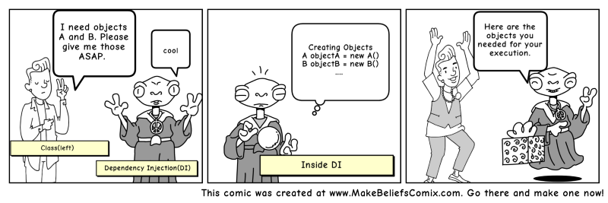

Slide 6
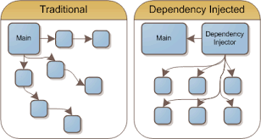
Dependency Injection

Slide 7
Dependency Inversion Principle
public class Messaging {
MessageService service;
public void sendMssage(){
service.sendMessage();
} }
public interface MessageService {
public String sendMessage();
}
public class Email implements MessageService {
public String sendMessage() { }
}
High-level modules should not depend on low-level modules.
Both should depend on abstractions.
High Level Module
Abstraction
Low Level Module

Slide 8
Dependency Inversion Principle
  High level modules should not depend upon low level modules.
  Low and High Modules should depend upon abstractions.
  Low modules should NOT define a interface that Higher Level module depend on
  Higher Level Module should define an interface that lower level module must implement
This gives the flexibility at the cost of increased effort.

Slide 9
Inversion of Control Container(IoC)
A container that supports Dependency Injection.
No Need to create objects but describe how they should be created.
Describe which services are needed by which components by configuration file.
Objects are given their dependencies at creation time by the IoC
IoC - inversion of responsibility with regard to how an object obtains references to collaborating objects.

Slide 10

The Container

Slide 11
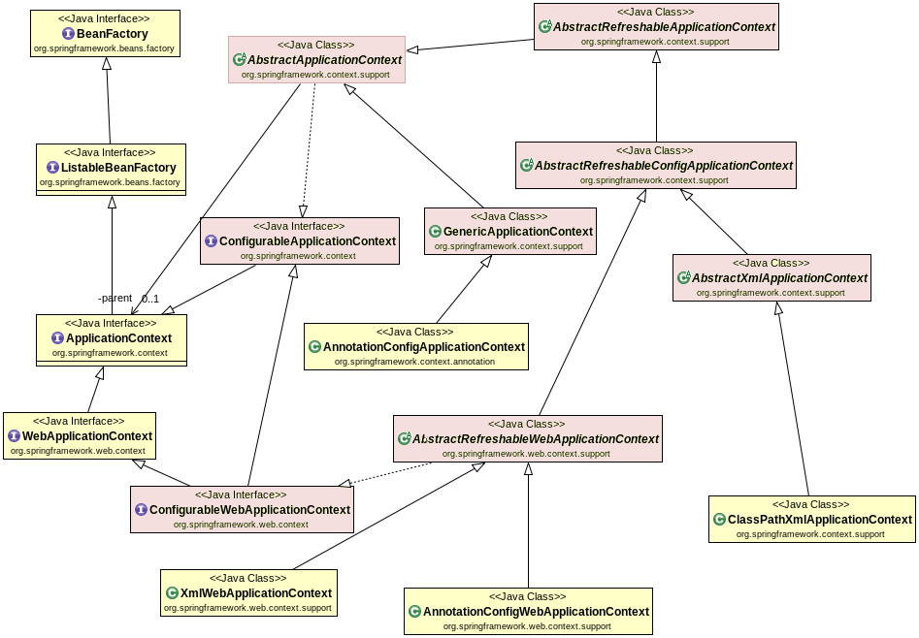
Container Hierarchy

Slide 12
Beans
A bean is an object that is instantiated, assembled, and otherwise managed by a Spring IoC container.
The “beans” are in the form of JavaBeans
  Present in a Named Package
  No Argument constructor
  getter and setter methods for the properties
  Can be controlled for scope, life cycle and callbacks.
Beans are singletons by default
  "one bean per bean id in a container".
Beans are Eagerly Initialized by default

Slide 13
Configuration Meta-Data
Spring Container uses the meta-data to instantiate, configure, and assemble the objects of the Application
XML-based metadata and Annotation Based metadata can be used to form configuration metadata.
Configuration consists of one or more bean definition.
Beans are configured as <bean/> elements inside a top-level <beans/> element.

Slide 14
Simple XML Configuration
  <?xml version="1.0" encoding="UTF-8"?>
  <beans xmlns="http://www.springframework.org/schema/beans"
  xmlns:xsi="http://www.w3.org/2001/XMLSchema-instance"
  xsi:schemaLocation="http://www.springframework.org/schema/beans
  http://www.springframework.org/schema/beans/spring-beans.xsd">
  <bean id="..." class="...">
  <!-- collaborators and configuration for this bean go here -->
  </bean>
  <!-- more bean definitions go here -->
  </beans>
  <bean id="" class="" scope="singleton"/>. //DEFAULT
  <bean id="" class="" scope="prototype"/>

Slide 15
Setter Dependency Injection
  <?xml version="1.0" encoding="UTF-8"?>
  <beans xmlns="http://www.springframework.org/schema/beans"
  xmlns:xsi="http://www.w3.org/2001/XMLSchema-instance"
  xsi:schemaLocation="http://www.springframework.org/schema/beans http://www.springframework.org/schema/beans/spring-beans.xsd">
  <bean id="custBean" class="com.training.domains.Customer">
  <property name="customerNumber" value="1010“/> <property name="customerName" value="Ramesh“/> <property name="handPhone" value="90898989“/>
  </bean>
</beans>

Slide 16
Application Context
ClassPathXmlApplicationContext:
  Loads a context definition from an XML file located in the classpath,
  context definition files as classpath resources.
FileSystemXmlApplicationContext
  Loads a context definition from an XML file in the file system.
XmlWebApplicationContext
  Loads context definitions from an XML file contained within a web application.

Slide 17
Bean Lookup
To interact directly with the bean Container to get a specific bean according to its name, type, or both.
This is done with overloaded methods getBean() defined in interface FactoryBean.
This interface is implemented by ApplicationContext classes.
ApplicationContext ctx = ...
  MyBean beanRef = (Bean) ctx. getBean (" beanID");
  MyBean beanRef = ctx. getBean (" beanID ", MyBean. class );
  MyBean a = ctx. getBean (MyBean. class );

Slide 18
Spring Application
package com.training.applications;
import org.springframework.beans.factory.BeanFactory;
Import org.springframework.context.support.FileSystemXmlApplicationContext;
import com.training.domains.Customer;
public class QuickStart {
  public static void main(String[] args) {
BeanFactory fact =new FileSystemXmlApplicationContext("bean.xml");
Customer cust =(Customer)fact.getBean("custBean2");
System.out.println(cust);
  }
  }

Slide 19
Maven Dependecny
  <dependency>
  <groupId>org.springframework</groupId>
  <artifactId>spring-context</artifactId>
  <version>6.0.22</version>
  </dependency>

Slide 20
Lazy-initialized beans
ApplicationContext implementations eagerly create and configure all singleton beans as part of the initialization process.
A lazy-initialized bean tells the IoC container to create a bean instance when it is first requested, rather than at startup.
<bean id="lazy" class="com.training.Invoice " lazy-init="true"/>
<bean name="notlazy" class="com.training.Invoice"/>

Slide 21
Configuration Meta Data
Instructs IoC Container to instantiate, configure, and assemble the objects
Can be done in XML format
  Supported from Spring 2.0
Can be done with Annotation
  Supported from Spring 2.5
Can be done with Just Java
  Supported from Spring 3.0

Slide 22
Dependency Injection
Dependencies between the beans can be Injected by following ways
  Setter Injection
    Uses setter method to set the value
  Constructor Injection
    Happens at Object creation itself
  Field Injection (@Autowired at field)
    Uses reflection to set the values of private variables
      @Autowired
      private UserService userService;

Slide 23
Constructor Injection
Dependency can be one of the following
    Injected via a class constructor
    primitive and String-based values
    Dependent object (contained object)
    Collection values
  @Component
  public class UserController {
  private UserService userService;
  @Autowired
  public UserController(UserService userService){
  this.userService = userService; }
  }

Slide 24
Setter Injection
Setter Injection
  Injected via setter methods
  Allows flexible initialization
  Requires Java Bean conventions to be followed
    Can add post initialization checking methods
  private UserService userService;
  @Autowired
  public void setUserService(UserService userService){
  this.userService = userService;
  }

Slide 25
Field Injection
Minimal Boilerplate Code:
  Concise way to declare a dependency.
  Doesn’t need a constructor or a setter method
Ease of Use:
  It's quick and easy for developers to add a new dependency.
Visual Simplicity
  When a class has very few dependencies, they are all visible at the top

Slide 26
REGISTERING BEANS

Slide 27
Strereo type Annotation
Class-level marker that defines the specific role or purpose of a component within the overall application architecture.
Found in the org.springframework.stereotype package and serve as metadata to instruct Spring on how to manage the class.
Automatic Bean Discovery
  Looks for classes marked with these annotations. If found, Spring automatically creates an instance (a "bean") and registers it in the Application Context.
Architectural Categorization
  Logically group components into specific layers, such as the presentation layer (@Controller), the business layer (@Service), or the data access layer (@Repository).
Layer-Specific Behavior
  Some trigger specialized framework behaviors,
Notes:
I

Slide 28
@ Component
@Component
  Spring can scan all the beans through auto scan if the class has this or similar annotation
The Registered Beans can be access by Its name
  The Name is first Character of the Class Name in lowercase
  ‘CustomerService’ to ‘customerService’.
CustomerService cust = (CustomerService)context.getBean("customerService");
@Component(“custService”)
  Can Customize the component name by passing a string value

Slide 29
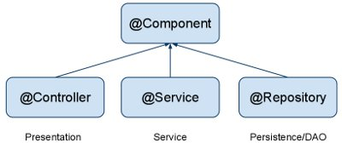
Stereo Types
@Component
  Indicates a auto scan component.
@Repository
  Indicates DAO component in the persistence layer.
@Service
  Indicates a Service component in the business layer.
@Controller
  Indicates a controller component in the presentation layer.

Slide 30
@Repository
To denote Spring bean as a data repository
Catch platform specific exceptions
  Re-throw them Spring specific unchecked exception.
  Done by the PersistenceExceptionTranslationPostProcessor.
PersistenceExceptionTranslationPostProcessor
  Adds an advisor to the repository beans.
Notes:
Special Behavior:

Slide 31
@Controller and @RestConroller
@Controller
  DispatcherServlet specifically scans for classes with this annotation to detect @RequestMapping methods.
  By default, methods return a view name
  To be resolved by a View Resolver.
@RestController
  Implicit @ResponseBody
  No need to add @ResponseBody to every method; it is applied to all handler methods in the class by default.
  Instead of searching for a view, it directly serializes the return object into the HTTP response body as JSON or XML using HttpMessageConverters.

Slide 32
@Bean
Method-level annotation in Class annotated @Configuration
Added to the public Method of the configuration class
  Methods should not be private or final
Method should return an object that should be registered as a Bean
Supports following attributes
  init-method
  destroy-method
  autowireCandidate
  name

Slide 33
Register Bean
Beans can also be registered with Java Based Configuration
  Done in the Java class with @Configuration Annotation
    This class acts as a source of Bean Definitions
  @Configuration
  public class EmployeeConfig {
  @Bean
  public Employee idOfTheBean(){
  return new Employee();
  }
  @Bean (name=“ram”) // bean Id overridden with name attribute
  public Employee employee(){
  return new Employee();
  }
  }

Slide 34
Spring Boot
Extension of the Spring framework
  A faster and more efficient development
Eliminates the boilerplate configurations required for setting up a Spring application.
  Opinionated ‘starter’ dependencies to simplify build and application configuration
  Embedded server to avoid complexity in application deployment
  Metrics, Health check, and externalized configuration
  Automatic configuration whenever possible

Slide 35
Spring Initializr
https://start.spring.io/
  A web-based UI tool provided by the Pivotal
  Used to generate the structure of the Spring Boot Project.
  Can configure the list of dependencies
  Package downloaded as Jar or War file
  Import as a Maven Project into STS

Slide 36
Spring Boot Starters
Set of convenient dependency descriptors
Eliminates the need to hunt through sample code
No need to copy-paste loads of dependency descriptors.
Contains lot of the dependencies that are required to get a project up and running
Also has support of managed transitive dependencies.

Slide 37
Creating a Spring Boot Project
In the Eclipse IDE Right-click in the package explorer and select New -> Spring Starter Project
A screen opens with some details which can be changed or can accept the default values for a simple project
The entry point of a Spring Boot application is the class which is annotated with @SpringBootApplication:
Uses this class with public static void main entry-point to launch an embedded web server.

Slide 38
Spring Boot Bootstrap
  @SpringBootApplication
  public class Application {
  public static void main(String[] args) {
  SpringApplication.run(Application.class, args);
  }
  }
Spring Boot can scan all the classes in the same package or sub packages of Main-class for components.
Equivalent to using @Configuration, @EnableAutoConfiguration, and @ComponentScan with their default attributes,

Slide 39
SPRING APPLICATION

Slide 40
Boot Application Execution
Stop Watch Starts
main()
Refresh Context
Prepare Environment
Print Banner
Trigger Runners
run()
Start the IoC Container
Return IoC container Application Context

Slide 41
SpringApplication
SpringApplication
  Class to bootstrap a Spring application from a Java main method.
  Creates an appropriate ApplicationContext instance
  Registers a CommandLinePropertySource to expose command line arguments as Spring properties,
  Refreshes the application context, loading all singleton beans, and triggers any CommandLineRunner beans.

Slide 42
SpringApplicationBuilder
A builder for SpringApplication and ApplicationContext instances
  Convenient fluent API and context hierarchy support.
  ConfigurableApplicationContext ctx=new SpringApplicationBuilder(DemoApplication.class)
  .lazyInitialization(false)
  .run(args);

Slide 43
SpringApplicationBuilder
ConfigurableApplicationContext ctx=
new SpringApplicationBuilder(
ApiGateway1Application.class)
.properties("spring.config.name:customapp")
.build().run(args);
ctx.close();
Customapp => refers to customapp.yml

Slide 44
Spring Application Builder
  ConfigurableApplicationContext ctx =
new SpringApplicationBuilder(SpringBootApplication.class)
    .web(WebApplicationType.NONE)
    .bannerMode(Mode.OFF)
    .build()
    .run(args);

Slide 45
AUTO CONFIGURATION

Slide 46
Auto Configuration
Spring Boot takes an opinionated view of the Spring platform and third-party libraries
  Can get started with minimum effort
  It tries to read “.properties” from various hard-coded locations.
  It also reads the “spring.factories” file
    Part of auto configure-module
    Determines the Auto Configurations it should evaluate.

Slide 47
Auto Configuration
Some Spring Boot Jars contain special JSON meta-data files that the editor looks for
  These files contain information about the known configuration properties.
“spring-boot-autoconfigure-XXX.jar”
  META-INF/spring-configuration-metadata.json”.
  Can find properties like server.port being documented there.

Slide 48
AutoConfigurations
Auto-registered @PropertySources
Spring Boot will automatically register these PropertySources
It has a default set of property locations that it always tries to read
  command line arguments
  application.properties inside .jar file etc.
  Can view the autoconfigure report by enabling debug =true in properties file
    debug:true in yaml file

Slide 49
Auto Configurations
Enhanced Conditional Support
@Conditional
  A low level annotation
Spring Boot has set of additional @Conditional annotations
@ConditionalOnBean(DataSource.class).
  The condition is true only if the user specified a DataSource @Bean in a @Configuration.
@ConditionalOnExpression("someSpELExpression).
  The condition is true if the SpEL expression is true.
@ConditionalOnJava(JavaVersion.EIGHT).
  The condition is true if the current Java version is 8.

Slide 50
YAML

Slide 51
Yaml
YAML is a superset of JSON
A convenient format for specifying hierarchical configuration data.
SnakeYAML
  Jar file added to the class path
  Spring Boot automatically supports YAML as an alternative to properties
  application.properties takes precedence over application.yml
    If both of them are present

Slide 52
YAML
Spring provides two convenient classes that can be used to load YAML documents.
YamlPropertiesFactoryBean
  To load YAML as Properties
YamlMapFactoryBean
  To load YAML as a Map.

Slide 53
Yaml
.yml file is advantageous over .properties file
  Has type safety,
  Hierarchy
  supports list
YAML supports lists as hierarchical properties or inline list
my:
servers:
- dev
- prod
servers: [dev, prod]

Slide 54
ADVANCED BEAN CONFIGURATIONS

Slide 55
Auto Wiring of Bean
@Autowired :
  Used to auto wire bean on the setter method, constructor or a field.
  It uses auto wire bean by matching data type.
  @Autowired(required =false)
  Exception will be thrown when matching bean is not found
  required attribute is used to disable this checking
  Will leave the property unset.
@Qualifier
  Used to control which bean should be autowired on a field.
  If there are two similar beans, can specify the bean name to wire

Slide 56
Disambiguation options
  @Component
  public class TourAgent {
  private int id;
  private String agentName;
  private long mobileNumber;
  }
  @Bean
  public TourAgent tourAgent() {
  return new TourAgent(1033,"Ram",7484848);
  }

Slide 57
Disambiguation options
  Properties props = new Properties();
  props.put(
  "spring.main.allow-bean-definition-overriding", "true");
  ConfigurableApplicationContext ctx =
  new SpringApplicationBuilder(TourServiceApplication.class)
  .properties(props)
  .build()
  .run(args);

Slide 58
@Primary
Used to give higher preference to a bean, when there are multiple beans of same type.
Used on any class directly or indirectly annotated with @Component or on methods annotated with @Bean
If a bean has @Autowired without any @Qualifier
  Multiple beans of the type exist
  Candidate bean marked @Primary will be chosen
@Qualifier should be used in conjunction with @Autowired always.
@Primary should be used in conjunction with @Bean

Slide 59
@Primary
  @Bean
  @Primary
  public Service myService() {
  return new Service();
  }
  @Bean
  public Service backupService() {
  return new Service();
  }
  getBean(Service.class) will return the primary bean

Slide 60
Life Cycle Methods
  @Component
  public class Invoice {
  @PostConstruct
  public void myInit() { }
  @PreDestroy
  public void myDestroy() { }
  }
  Can be Done with Factory Methods
  @Bean(initMethod=“init",destroyMethod="close")
  public Employee myBean() {
  return new Employee(202,”Ramesh”);
  }

Slide 61
Need for Life Cycle Methods
  public class DeliveryExecutive {
  @Autowired
  private Environment env;
  public DeliveryExecutive{
  env.getActiveProfiles() -> Will throw Null Pointer Exception
  }
  public void init() {
  log.info("Init Method called");
  log.info(env.getActiveProfiles().toString());
  System.out.println(Arrays.asList(env.getDefaultProfiles().toString()));
  }
  }

Slide 62
CONFIGURATION PROPERTIES

Slide 63
@ConfigurationProperties.
Spring Boot supports externalized configuration
  Can access properties defined in properties files.
Custom properties
Spring Properties Editor won’t be aware of these properties.
  Need to make the spring Editor aware of these properties
pom.xml
  <dependency>
    <groupId>org.springframework.boot</groupId>
    <artifactId>spring-boot-configuration-processor</artifactId>
  </dependency>

Slide 64
Custom Property
resources/META-INF/additional-spring-configuration-metadata.json
  File is used to register additional used defined properties
  {"properties": [
  {
  "name": "com.training.custom.propName",
  "type": "java.lang.String",
  "description": "A description for 'com.training.custom.prop-name'"
  }
  ]}

Slide 65
Custom Property in application.yml
  com:
  training:
  custom:
  propName: dev-profile
  server:
  port: 8082

Slide 66
@ConfigurationProperties
@ConfigurationProperties works best with hierarchical properties that all have the same prefix.
Spring will automatically bind any property defined in property file
  Since version 2.2 @ConfigurationProperties classes are detected via classpath scanning.
  @Component or @EnableConfigurationProperties is not required

Slide 67
Define Property in Java Bean
  @FieldDefaults(level = AccessLevel.PRIVATE)
  @NoArgsConstructor
  @Data
  @ConfigurationProperties(prefix = "com.training.custom")
  @Component
  public class Customer {
  int id;
  String name;
  String email;
  private String propName;
  }

Slide 68
Define Property on Factory Method
  @Bean
  @ConfigurationProperties(prefix = "com.training.custom")
  public Customer magesh() {
  return new Customer(101,"magesh","mag@abc.com");
  }

Slide 69
PROFILES

Slide 70
Profiles
A way to segregate parts of application configuration and make it only available in certain environments.
Used to control two things:
  Influence the application properties
  Which beans are loaded into the application context.
@Profile
  Used to Create profiles .
  Can be attached to an @Configuration Class
    Can also be attached to @Bean Factory Method.

Slide 71
Application.yml
  spring:
  config:
  activate:
  on-profile:
  - dev
  server:
  port: 6060
  logging:
  level:
  '[org.springframework.boot]': trace
  --- => (Three Hypens)

Slide 72
Application.yml
  spring:
  config:
  activate:
  on-profile:
  - prod
  server:
  port: 6065
  logging:
  level:
  '[org.springframework.boot]': info

Slide 73
Creating Beans Based on Profiles
  @Bean
  @Profile(value = "dev")
  public Customer ram() {
  return new Customer(101,"Developer Ramesh","ram@abc.com");
  }
  @Bean
  @Profile(value = "prod")
  public Customer shyam() {
  return new Customer(102,"Admin Shyam","shy@abc.com");
  }

Slide 74
SPRING BOOT RUNNERS

Slide 75
Command Line Runner
A Functional Interface
A special bean that execute some logic after the application context is loaded and started.
  They are Created within the same application context
  Can create Multiple CommandLineRunner beans
  It can be ordered using the Ordered interface or @Order annotation.
  Has a run() method that accepts array of String as an argument

Slide 76
Command Line Runner
  @Bean
  public CommandLineRunner commandLineRunner() {
  return (args) -> {
  for(String eachArg:args) {
  System.out.println(" Info"+eachArg);
  }
  } ;
  }

Slide 77
Building Application
mvn package
Can Use the Generated jar to Execute the application.
java -jar target/mymodule-0.0.1-SNAPSHOT.jar
java -jar -Dspring.profiles.active=prod hospital-service.jar

Slide 78
SPRING BEAN SCOPES
Self Study Notes

Slide 79

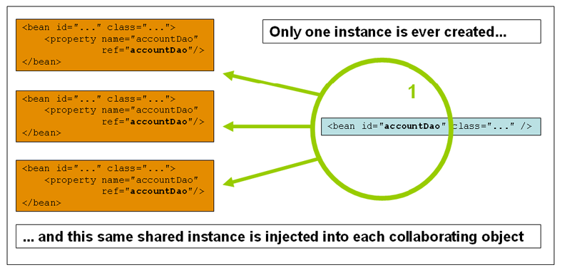
Singleton

Slide 80
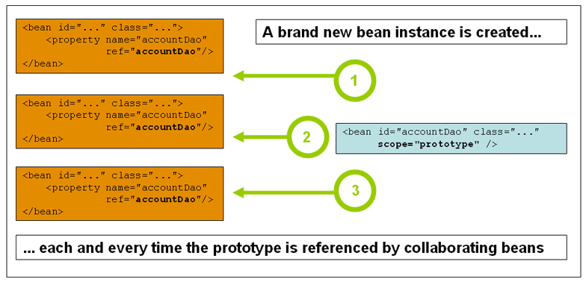
Prototype Scope

Slide 81
Bean Scope
The Bean Scope for Standard Java SE Beans are singleton:
@Scope(scopeName=ConfigurableBeanFactory.SCOPE_SINGLETON)
  Scopes a single bean definition to a single object instance per Spring IoC container, per container and per bean.
  Single instance will be stored in a cache and all subsequent requests and references will result in cached object being returned.
@Scope(value=ConfigurableBeanFactory.SCOPE_PROTOTYPE)

Slide 82
Bean Scope
The Bean Score for Standard Java SE Beans are singleton:
Scopes a single bean definition to a single object instance per Spring IoC container, per container and per bean.
prototype:
  Prototype results in the creation of a new bean instance every time a request for that specific bean is made
  Can change the Scope by
@Scope(value=ConfigurableBeanFactory.SCOPE_PROTOTYPE)

Slide 83
Test the Scopes
  DiscountService service = ctx.getBean(DiscountService.class);
  DiscountNotification protoBean;
  protoBean = service.getDiscount("april");
  log.info("Discount :="+protoBean.showDiscount());
  protoBean = service.getDiscount("may");
  log.info("Discount :="+protoBean.showDiscount());

Slide 84
Lazy Initialization
Beans are created as they are needed rather than during application startup.
  Enabling lazy initialization May improve the startup time of the application
  In a web application, enabling lazy initialization will result in many web-related beans not being initialized until an HTTP request is received.

Slide 85
Lazy Initialization
It can delay the discovery of a problem with the application.
If a misconfigured bean is initialized lazily, a failure will no longer occur during startup and the problem will only become apparent when the bean is initialized.
May reduce the number of beans created when the application is starting

Slide 86
Lazy initialization
Can be enabled programmatically using Spring Application Builder
Can be enabled using property from spring boot 2.2
  spring.main.lazy-initialization=true
Can be enabled by using the @Lazy on the Factory Method

Slide 87
Lazy-initialized beans
  @Bean()
  @Lazy(value=true)
  public Employee myBean() {
  System.out.println("Loading LazyBean bean");
  return new Employee(employee_Id,employee_Name);
  }

Slide 88
Lazy-initialized beans
ApplicationContext implementations eagerly create and configure all singleton beans as part of the initialization process.
A lazy-initialized bean tells the IoC container to create a bean instance when it is first requested, rather than at startup.
  @Bean()
  @Lazy(value=true)
  public Employee myBean() {
  System.out.println("Loading LazyBean bean");
  return new Employee(employee_Id,employee_Name);
  }

Slide 89
@ComponentScan Filter
The Following annotated classes are registered as spring beans
  @Component, @Repository, @Service, @Controller
Can extend this behavior by using includeFilters and excludeFilters parameters of the @ComponentScan annotation.
Five types of filters of ComponentScan.Filter :
  ANNOTATION
  ASSIGNABLE_TYPE
  ASPECTJ
  REGEX
  CUSTOM

Slide 90
ASSIGNABLE_TYPE - Exclude
  To specify a type (class or interface), Spring will include only those components that are assignable to that type.
  @SpringBootApplication
  @ComponentScan(useDefaultFilters = true,basePackages = {"com.example.demo","org.training.demo"},
  excludeFilters = @Filter(type=FilterType.ASSIGNABLE_TYPE,
  classes = Dummy.class))
useDefaultFilters
  True-default,
  Scans for all @Component, @Service, etc., and adds whatever specified in includeFilters.
  False- Only scan for the types explicitly listed in include Filters.

Slide 91
ASSIGNABLE_TYPE - Include
  @ComponentScan(
  basePackages = {"com.example.demo", "org.training.demo"},
  includeFilters = @Filter(
  type = FilterType.ASSIGNABLE_TYPE,
  classes = MyExistingInterface.class // Any class implementing this will become a bean
  )
  )

Slide 92
Application.yml in different location
  @Bean
  public PropertySourcesPlaceholderConfigurer props() {
  PropertySourcesPlaceholderConfigurer config = new PropertySourcesPlaceholderConfigurer();
  YamlPropertiesFactoryBean yaml = new YamlPropertiesFactoryBean();
  yaml.setResources(new FileSystemResource("e:\\application.yml"));
  config.setProperties(yaml.getObject());
  return config;
  }

Slide 93
Disable Web Server
application.yml
  spring.main.web-application-type=none
  Code
  SpringApplication app = new SpringApplication(MyApplication.class);
  app.setWebApplicationType(WebApplicationType.NONE);
  app.run(args);

Slide 94
Constructor argument name and type
<bean id="exampleBean" class="examples.ExampleBean">
<constructor-arg name="years" value="7500000"/>
<constructor-arg name="ultimateanswer" value="42"/>
</bean>
The container can use type matching with simple types if types are explicitly specified
<bean id="exampleBean" class="examples.ExampleBean">
<constructor-arg type="int" value="7500000"/>
<constructor-arg type="java.lang.String" value="42"/>

Slide 95
Constructor argument index
Use the index attribute to specify explicitly the index of constructor arguments
<bean id="exampleBean" class="examples.ExampleBean">
<constructor-arg index="0" value="7500000"/>
<constructor-arg index="1" value="42"/>
</bean>
Resolving the ambiguity of multiple simple values,
Resolves ambiguity of two arguments of the same type.
The index is 0 based.

Slide 96
Constructor-based or setter-based DI?
Constructor arguments for mandatory dependencies and setters for optional dependencies.
Constructor dependency , disadvantage is that the object becomes less amenable to reconfiguration and re-injection.
A legacy class may not expose any setter methods, and so constructor injection is the only available DI.

Slide 97
Reference to Other Beans
The ref element is used to set the value of the specified property to be a reference to another bean managed by the container
  <bean id="custBean2" class="com.training.domains.Customer">
  <property name="customerNumber" value="1010"></property>
  <property name="addr" ref="addBean"></property>
  </bean>
  <bean id="addBean" class="com.training.domains.Address">
  <property name="addLine1" value="2 Gandhi St"></property>
  <property name="pincode" value="200202"></property>
  </bean>

Slide 98
Autowiring Properties
Beans may be auto-wired (rather than using <ref>)
  Per-bean attribute autowire
  Explicit settings override
autowire=“name”
  Bean identifier matches property name
autowire=“type”
  Type matches other defined bean
autowire=”constructor”
  Match constructor argument types

Slide 99
Auto wiring -byName
public class Bill {
private Customer cust;
private Invoice inv;
}
<bean id="bill_Bean" class="com.training.Bill" autowire="byName"/>
</bean>
<bean id="cust" class="com.training.Customer"> </bean>
<bean id="inv" class="com.training.Invoice"> </bean>

Slide 100
Auto wiring -byType
public class Bill {
private Customer obj1;
private Invoice obj2;
}
<bean id="bill_Bean" class="com.training.Bill" autowire="byType"/>
<bean id="cust" class="com.training.Customer "> </bean>
<bean id="inv" class="com.training.Invoice"> </bean>

Slide 101
Wiring Collections
<list>
  Wiring a list of values, allowing duplicates
<set>
  Wiring a set of values, ensuring no duplicates
<map>
  Wiring a collection of name-value pairs where name and value can be of any type
<props>
  Wiring a collection of name-value pairs where the name and value are both Strings

Slide 102
Using Collection Injection
  <bean id="custBean" class="com.training.domains.Customer">
  <property name="customerNumber" value="1010"></property>
  <property name="customerName" value="Ramesh"></property>
  <property name="handPhone" value="90898989"></property>
  <property name="landLines">
  <set>
  <value>2455878</value>
  <value>2466878</value>
  <value>2444878</value>
  </set>
  </property>
  </bean>

Slide 103
Using Collection Injection
  <bean id=" myBean " ... >
  <property name =" someProp ">
  <list >
  <ref bean =" otherBean "/>
  <ref bean =" someOtherBean "/>
  </ list >
  </ property >
  </ bean >

Slide 104
Life cycle Methods
  <bean id="exampleBean" class="com.example.ExampleBean" init-method="initMethod">
  <property name="message" value="Hello, World!"/>
  </bean>
  <bean id="exampleBean" class="com.example.ExampleBean" destroy-method=”cleanUp">
  <property name="message" value="Hello, World!"/>
  </bean>

Slide 105
Inheritance Configuration
  <!-- Parent -->
  <bean id="baseCustomer" class="com.example.Customer" abstract="true">
  <property name="country" value=”India"/>
  <property name="name" value=”Guest"/>
  </bean>
  <!-- Child Bean -->
  <bean id="customer" parent="baseCustomer">
  <property name="name" value=”Ramesh"/>
  <property name="email" value=”ram@example.com"/>
  </bean>

